Slide 1
Vision showcase activity
The National College of Computer Science
Elena Genoveva Irimia, Letitia Spataru, Diana Bejan, Raluca Ciocan, Carmen Zaharescu

Slide 2
Vision showcase
3 months has passed since our Cape Town meeting
We have worked on vision development, leadership and different innovation themes
Now it’s time for you to tell your story
These meeting will happen virtually with LiveMeeting
Each of the mentorship groups will present their current vision “thinking” and development
Following the presentation each school will receive feedback from their coach and Mentor Schools.

Slide 3
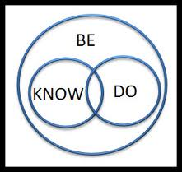
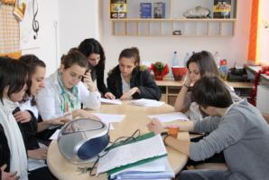
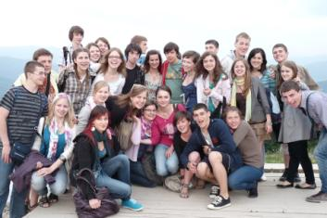
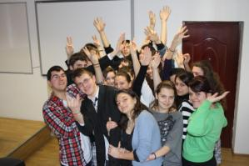
Vision of Innovation
What is your overall vision for your school?
“Exploit the leader in you!”
What does this mean?
Abilities
Creativity
Teamwork and teambuilding
Initiative
Trust
Respect

Slide 4
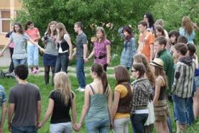
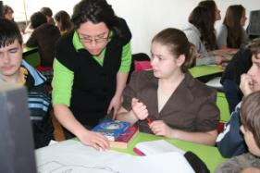
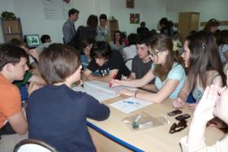
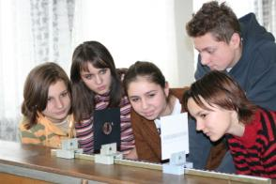
Vision of Innovation
The most important changes we envision for students:
Team work makes us stronger !
The voice of the students is the most important in implementation strategies, take decision, promote new projects.
Preparing students for the labour market of tomorrow!
Teaching students to be the future citizens of tomorrow!

Slide 5
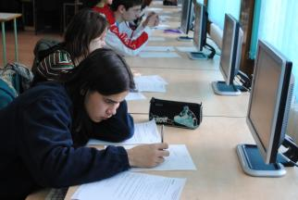
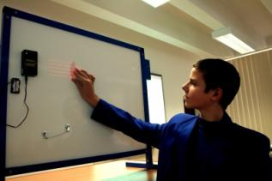
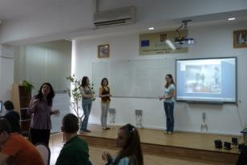
Vision of Innovation
How does this vision connect with your goals for being part of the Innovative Schools Program?
- developing the leadership culture in schools through our active participation in these Virtual Universities, the Leaders Forum in London, on the site “Partners in Learning” and the live meetings.
- implementing new strategies and instruments in fulfilling the mission of the school, using models of good practice.

Slide 6
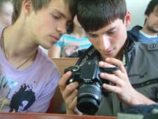
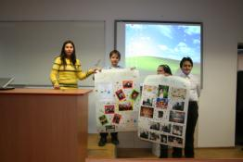
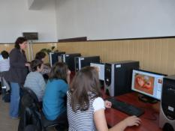
Current Status
What elements of your vision are in place now?
leadership =independence+interdependence+respect,+trust+motivation
we stimulate the experience exchange in learning;
leadership=finding the solutions to the problems of the local community;
familiarizing the teachers and the students with new IT tools facilitate learning beyond the school ;
Virtual identity for each classroom and each group.

Slide 7
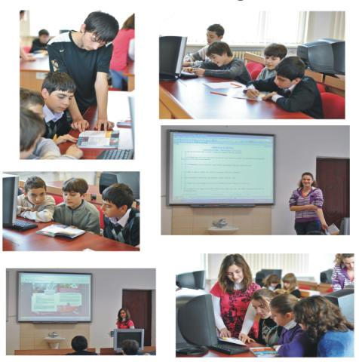
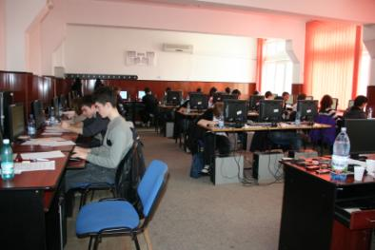
Current Status
What needs to be completed in this vision phase?
reshaping the relationship between parents and teachers through live meeting, online groups of discussion;
increasing the number of the work groups and the initiatives of implementing of new instruments and methods of learning;
developing more IT infrastructure that can allow learning, assessment and collaboration online

Slide 8
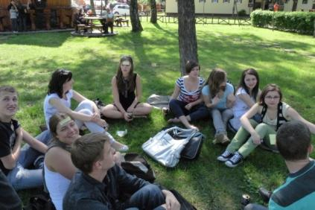
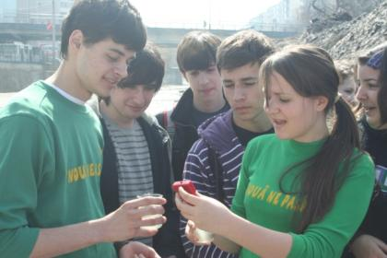
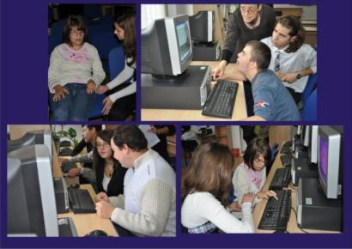
Current Status
What are the top 3 things you most want to change in the next two years?
to encourage and determine learning beyond the walls of the school
to develop E-learning platforms for all the subjects
To create the channels of communication with the parents
to intensify the impact of the school and students in the local community

Slide 9
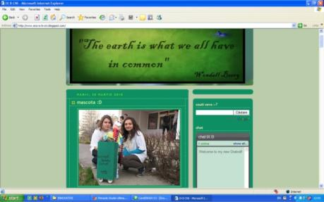
Ideas for Attaining the Vision
What are your thoughts about ways that your school’s vision is currently supported in each of the following possible areas?
Teaching, learning and assessment
Peer learning and assessment +group learning and assessment =
21st century skills.
Learn from your experience and from others expriences!
Accept the challenges! All of these means progress!
Leadership and culture of innovation
Independence in learning+ Active inter-dependence= The leader of the 21st century

Slide 10
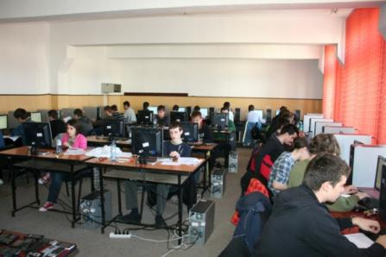
Ideas for Attaining the Vision
Capacity building
Everyone of us builds the whole.
Every opinion is important to create the big picture!
Learning environment development
Learning together, learning alone!
Learning in and outside the school!
Student voice
- involving students in the school decision board and in implementation;
- logistical and financial support of the students projects ;
- creating areas in the school where we can promote the projects and ideas and the results of the students.

Slide 11
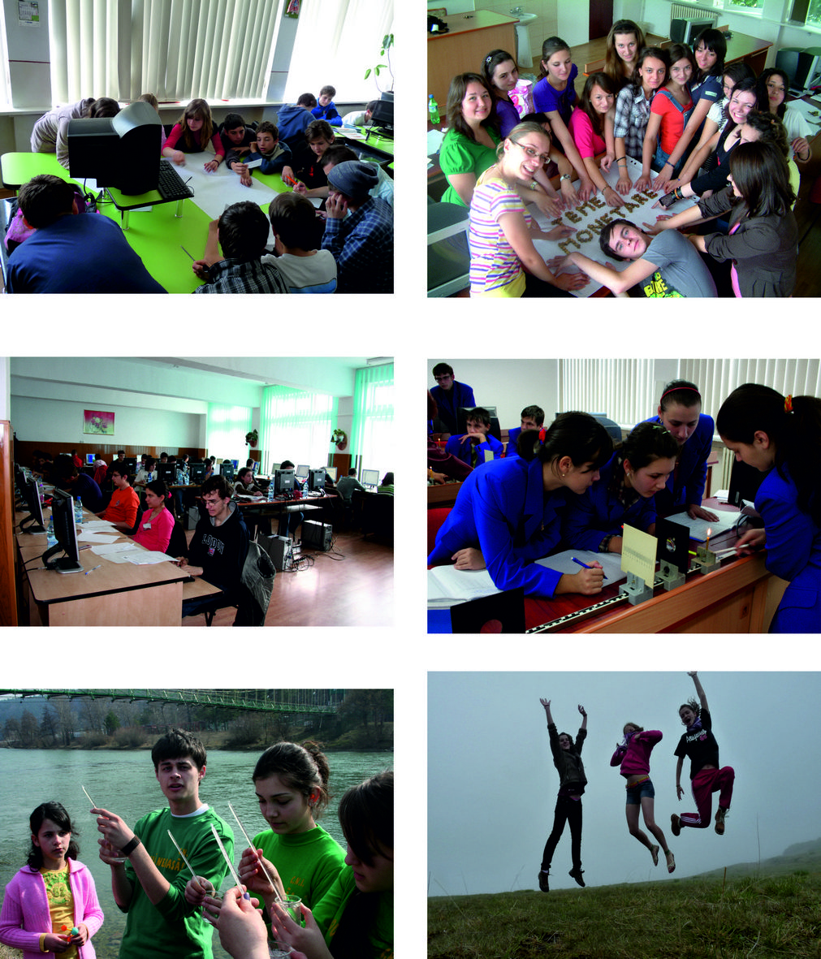
Our summary vision
Relationships teachers + students = a partnership where everyone involved can benefit: -the students will benefit from the scientific and practical knowledge of the teacher, the ability to create different educational environments; -the teacher will benefit from the vision of the students and the ability of the students to master new IT technologies; The school will support the learners initiative looking for logistical support The students will find solutions in solving the problems of the community A good opportunity to motivate and to encourage students. | “Exploit the leader in you!”
Environments the space of the school will be used to the maximum creating sitting rooms for every subject the area for every space will present the preoccupations/results of the students every classroom will be equipped with modular furniture and with a computer connected to the internet

Slide 12
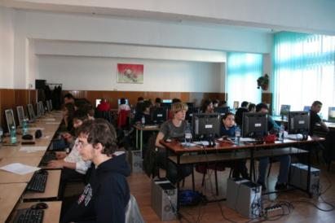
Our summary vision
Opportunities The 21st century- a challenge for the school, a certainty for the students! implementing e-Learning platforms for each subjects; developing optional courses and students clubs taking into account the students’ passions and abilities; different strategies of managing the classroom (group work, peer work, individual work and with computers with internet connection); | “Exploit the leader in you!”
Resources every teacher will have to know how to use didactical instruments and virtual applications to improve the didactical act and to communicate with the students; every student will be involved in the decision and implementation of the school vision and objectives.

Slide 13
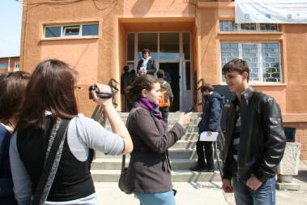
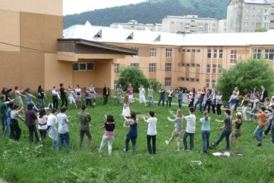
Our sumary vision
Distribution of Leadership You are important for the team. Team is important for you. Every idea and action counts for our vision/future. We want progress for everybody! Give us a little bit more that you are asked to do. This means a step forward for all our school. Share your ideas with all of us! Maybe you’ll find answers to your unspoken questions. | 1. increasing the voice of students 2. developing of new learning environment 3. implementing the team work and peer learning
Evaluation applying questionnaires to the students and the parents to insure the vision of the school; developing online channels of communication with the parents and students to obtain the feedback of the activities and results;

Slide 14
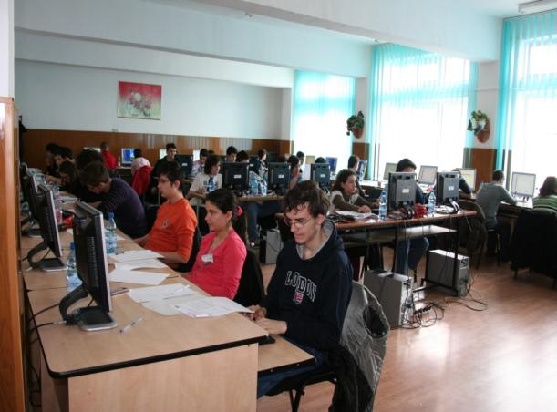
Evaluation
applying questionnaires to the students and the parents to insure the vision of the school;
developing online channels of communication with the parents and students to obtain the feedback of the activities and results;

Slide 15
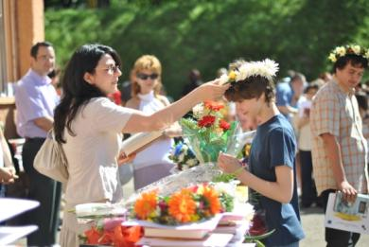
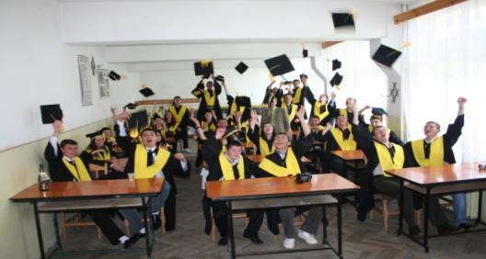
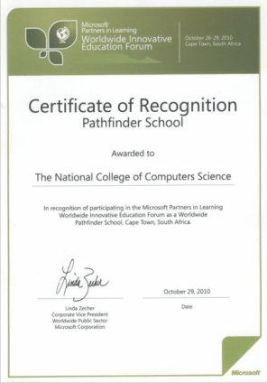
Recognition
winning awards and distinctions at the level of local and educational communities that will recognize and motivate the good practices;
sharing the results of the projects in the school, the media, on the site

Slide 16
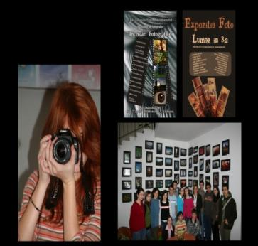
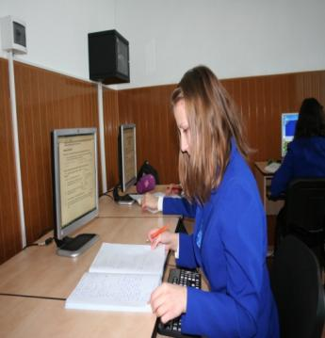
Anticipated Challenges
What challenges do you anticipate encountering along the journey toward achieving your vision?
- the limited financial resources will ensure a long term IT development
- the online communication between school and parents coming from rural areas will be difficult, because of the lack of the IT infrastructure in this area or because parents cannot master the use of internet

Slide 17
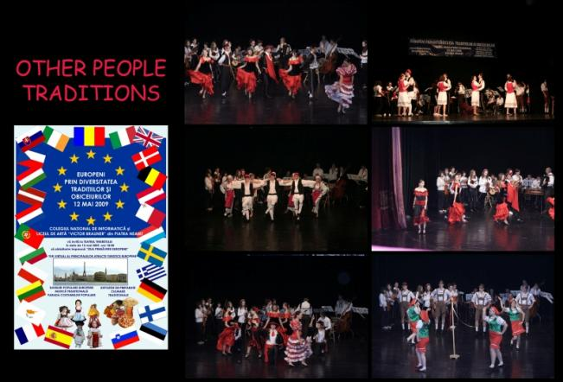
Anticipated Challenges
How have you overcome some of those?
we are acquiring funds through European projects for the transnational mobility of learners and the acquisition of equipments.
we are developing special courses to cater for the needs of the parents that live in rural areas

Slide 18
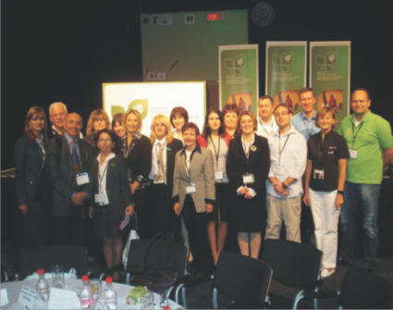
How can Innovative Schools community help?
Promoting didactical and IT tools.
Creating a virtual environment of education for the development of common projects.
Educating teachers and students through these Virtual Universities, live meetings, demonstrative activities, competitional challenges or projects.

