Slide 1





Slide 2
Blue represents the air
Yellow is the symbol of strength, wealth and purity
Red represents the blood shed in battle

Slide 3
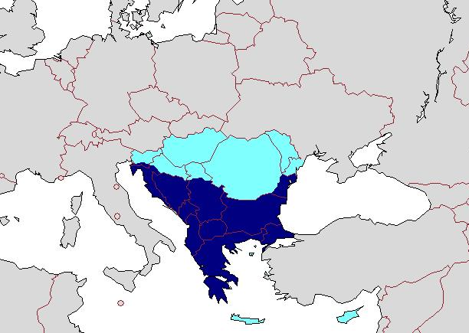
GENERAL INFO
Romania is one of the largest countries in the South-Eastern Europe.

Slide 4
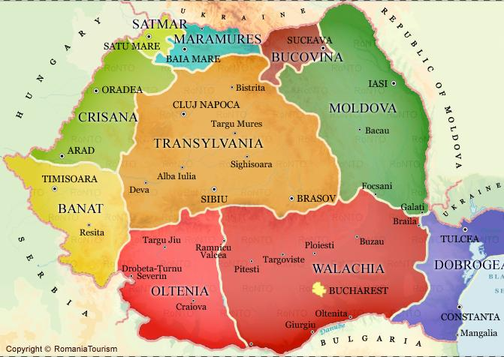
Population: 19,05 million
Capital: Bucharest
Regions:9
Counties: 41

Slide 5
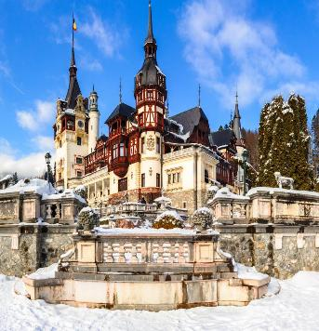
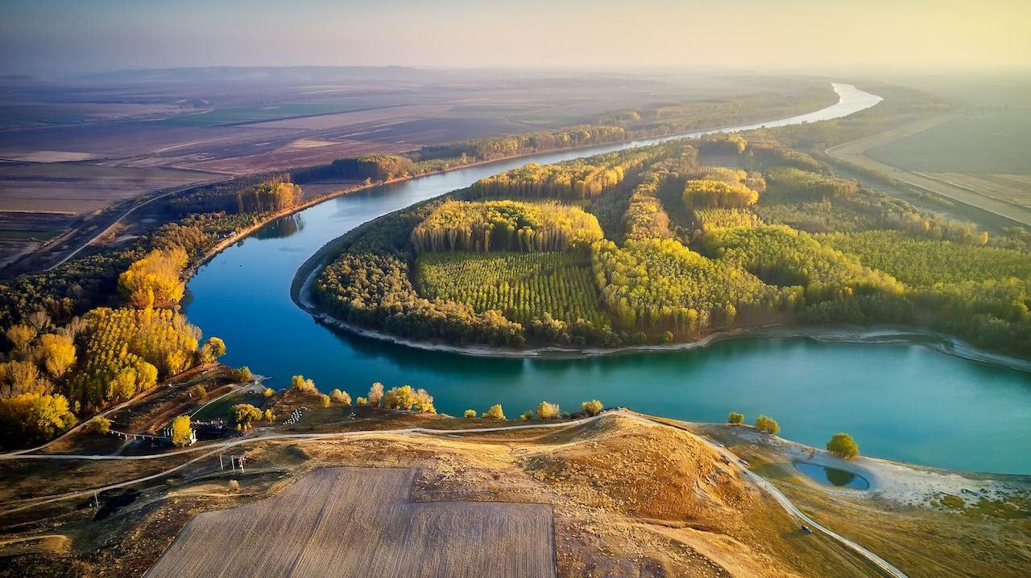
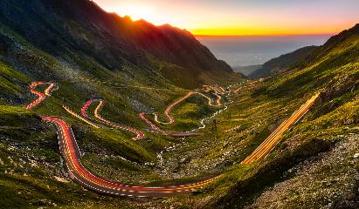
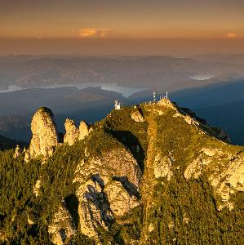
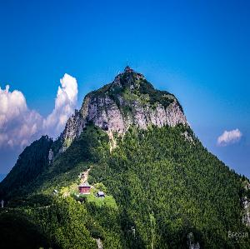
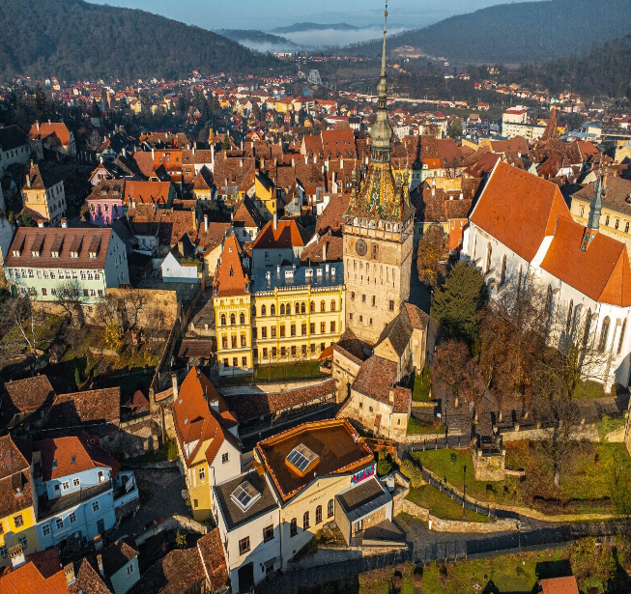
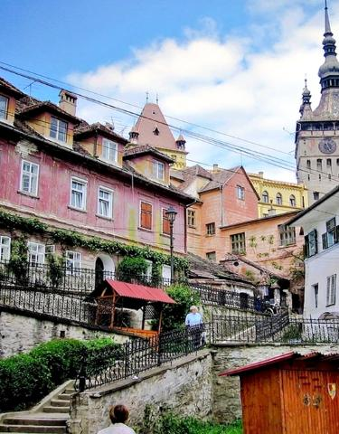
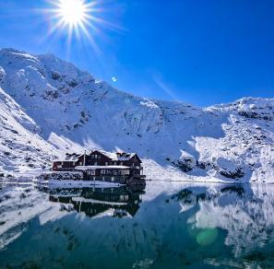
UNIQUE SCENERY FROM ROMANIA
Ceahlău Mountain
Transfăgărășan Road
Peleș Castle
Sighișoara Medieval City
Lake Bâlea

Slide 6
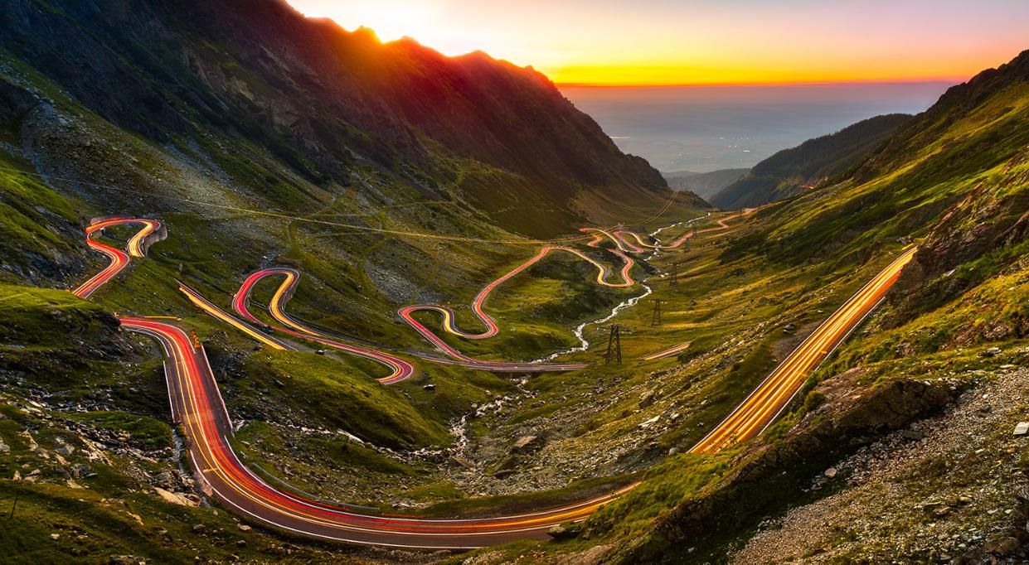
TRANSFĂGĂRĂȘAN
ROAD
Transfăgărășan is a 90-kilometer mountain road in Romania, winding through the Făgăraș Mountains. Built in the 1970s for strategic purposes, it reaches an altitude of 2,042 meters at its highest point near Balea Lake. Renowned for its stunning scenery and hairpin turns, it's a popular tourist attraction offering breathtaking views and challenging driving conditions.

Slide 7
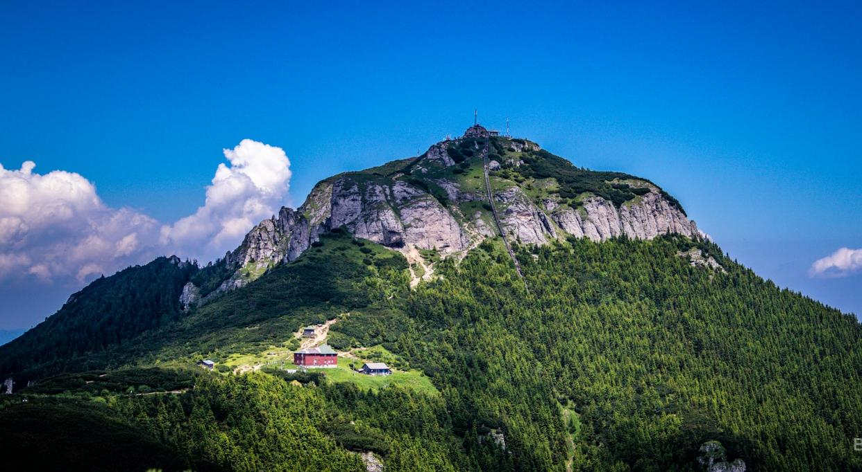
CEAHLĂU MOUNTAIN
The Ceahlău Massif, also referred to as Ceahlau Mountain, is one of the most renowned mountains in Romania. It's part of the Bistrița Mountains range, which is itself a division of the Eastern Carpathians mountain chain. The massif is located in Neamț County, within the Moldavia region of Romania .

Slide 8
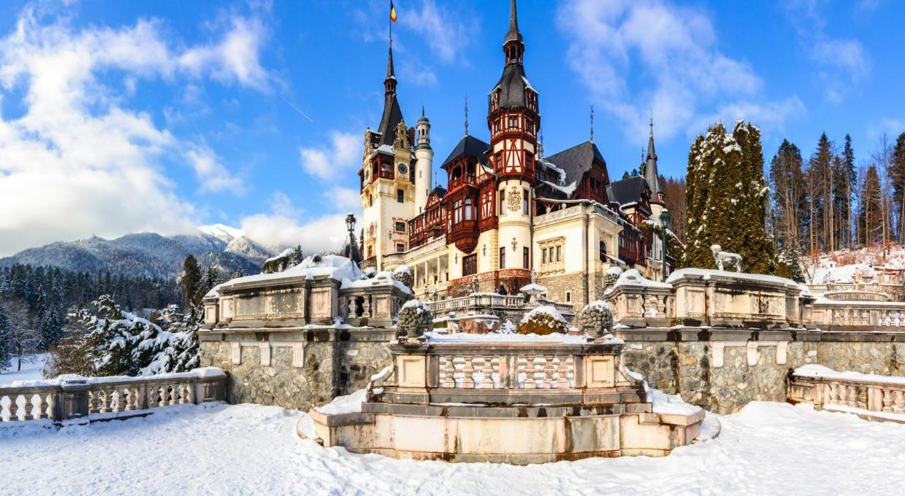
PELEȘ CASTLE
Peleș Castle is a stunning Neo-Renaissance palace nestled in the Carpathian Mountains of Romania. Built between 1873 and 1914, it served as the summer residence for the Romanian royal family. With its ornate architecture, lavish interiors, and picturesque surroundings, Peleș Castle is a popular tourist destination, offering a glimpse into Romania's rich history and royal heritage.

Slide 9
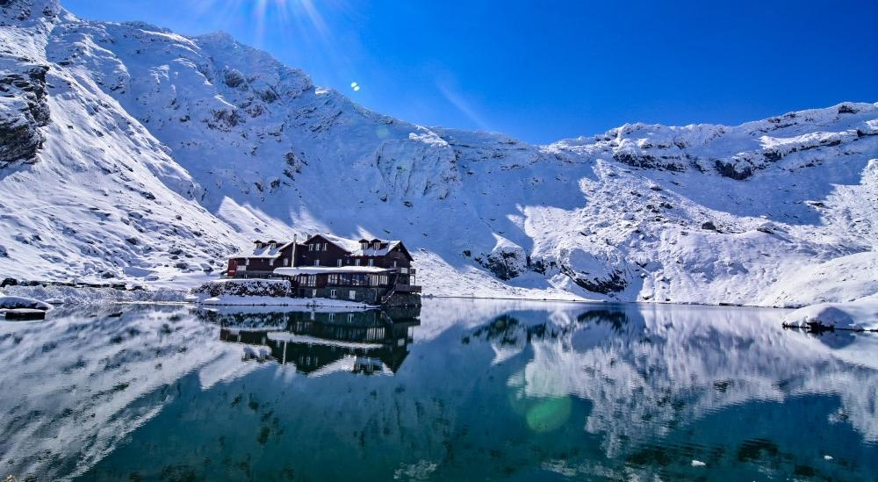
BÂLEA LAKE
Bâlea Lake is a glacial lake nestled high in the Făgăraș Mountains of Romania, at an elevation of 2,034 meters. It's accessible via the Transfăgărășan Road, offering breathtaking views and outdoor activities like hiking and boating in the summer, and skiing in the winter. The surrounding landscape is pristine, with rugged peaks and alpine meadows, making it a popular destination for nature enthusiasts and photographers alike.

Slide 10
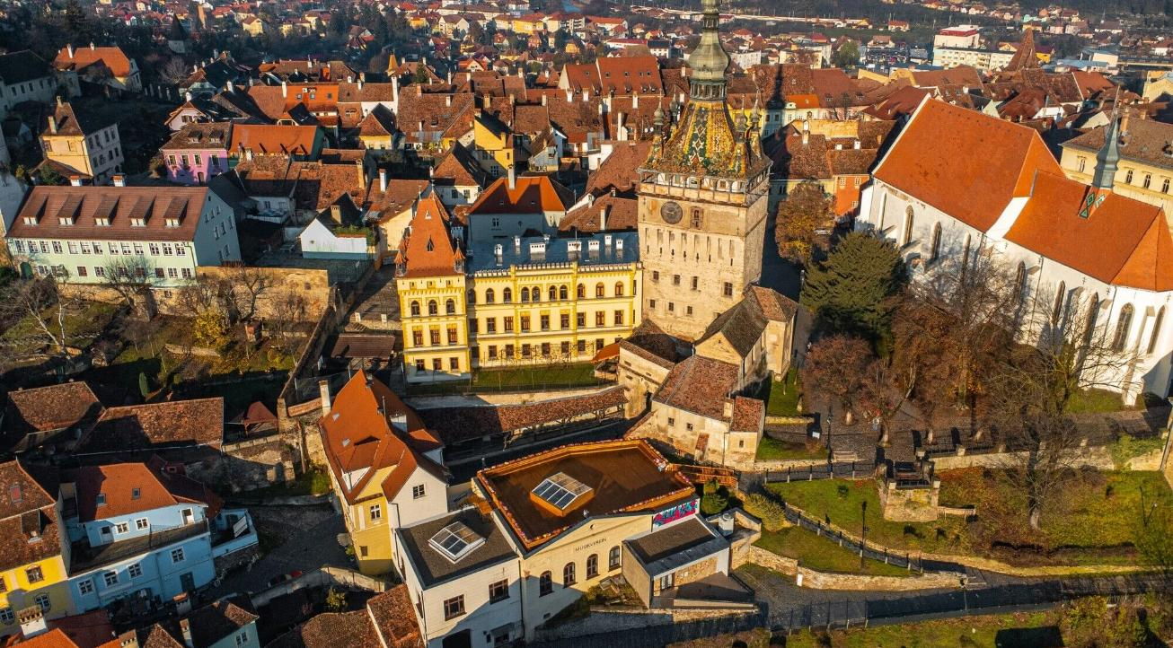
SIGHIȘOARA MEDIEVAL CITY
Sighisoara is a charming medieval city located in the heart of Transylvania, Romania. It's known for its well-preserved fortified old town, which is listed as a UNESCO World Heritage Site.

Slide 11
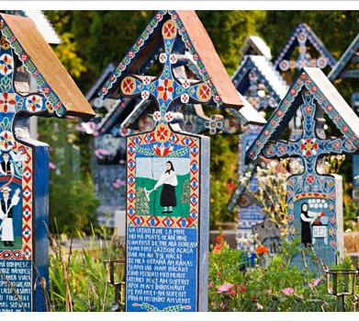
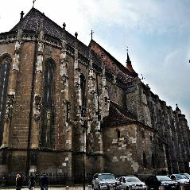
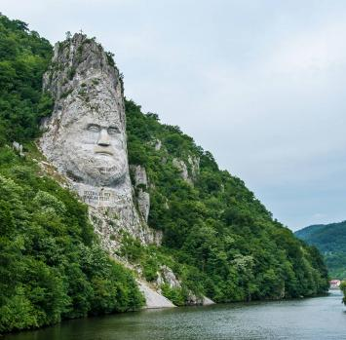
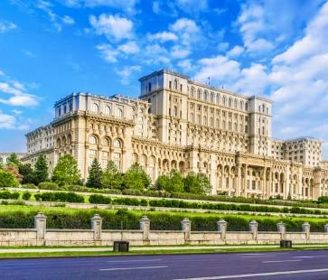
SOME FUN FACTS ABOUT ROMANIA
The biggest Gothic church is in Romania-The Black Church of Brașov is unparalleled in Eastern Europe, being the biggest Gothic church between Vienna and Istanbul.
Romania has a very ‘Happy Cemetery’
Romania Has Europe’s Largest Rock Sculpture
-Along the Danube, near the city of Orșova, there’s a rock sculpture of Decebal, which is 55 meters in height.
The Parliament Palace in Romania’s capital of Bucharest is the second largest building in the world, behind only the Pentagon. The building is 84m high. It is also the heaviest building in the world.

Slide 12
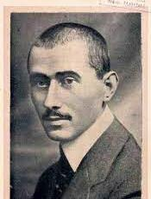
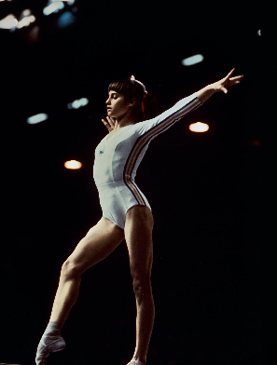
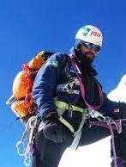
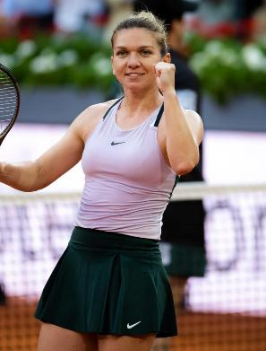
ROMANIA’S TALENTS

Slide 13
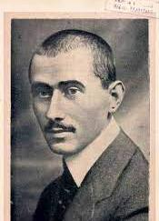
AUREL VLAICU
Aurel Vlaicu was a pioneering Romanian aviation engineer and inventor, born in 1882. He gained fame for designing and constructing the Vlaicu I and Vlaicu II airplanes, contributing significantly to the development of aviation in Romania. In 1913, he made an attempt to fly across the Carpathian Mountains, tragically ending in a fatal crash. Despite his untimely death, Aurel Vlaicu's contributions to aviation are remembered as foundational in Romania's aerospace history. His legacy lives on through his innovative designs and lasting impact on Romanian aviation.

Slide 14
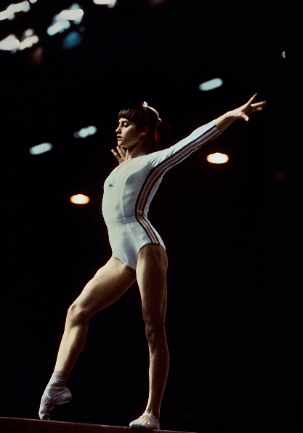
NADIA COMĂNECI
At the age of just 14, Nadia achieved the first perfect 10 in Olympic history for her performance on the balance beam. She went on to achieve six more perfect 10s in the same competition, becoming the first gymnast in history to do so. She won three gold medals at those games, along with a silver and a bronze.

Slide 15
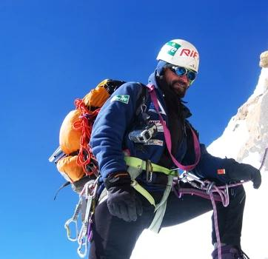
CONSTANTIN LĂCĂTUȘU
Constantin Lăcătușu is the first Romanian to climb Mount Everest in 1995. He tried once before but had to give up in order to save a man's life. Constantin was also the first man in the world to climb a mountain in Greenland. He was the first man to leave his mark on the mountain.
He also lives in our town Piatra Neamț.

Slide 16
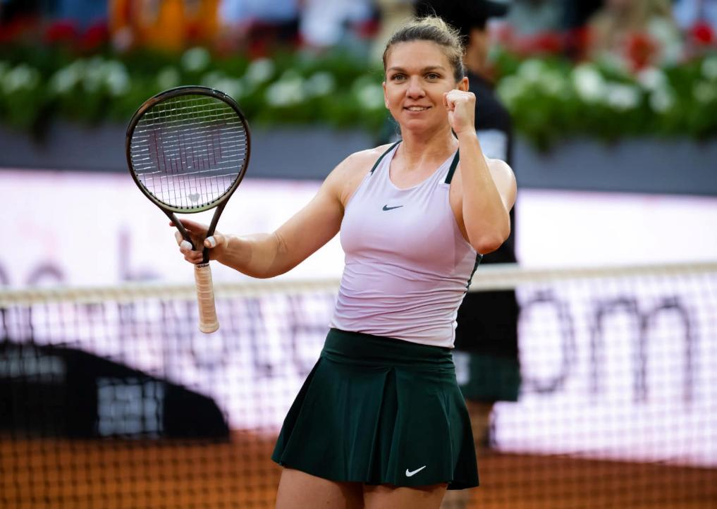
SIMONA HALEP
Simona Halep is a Romanian professional tennis player. She is widely regarded as one of the greatest tennis players of her generation. Halep's remarkable career has been highlighted by numerous achievements, including winning two Grand Slam titles. Also, she won Wimbledon in 2019, defeating Serena Williams in the final. Halep has also been ranked world No. 1 by the Women's Tennis Association (WTA) and has won multiple Premier Mandatory and Premier 5 tournaments. She is known for her speed, agility, and powerful groundstrokes, making her a formidable force on the tennis court.

Slide 17
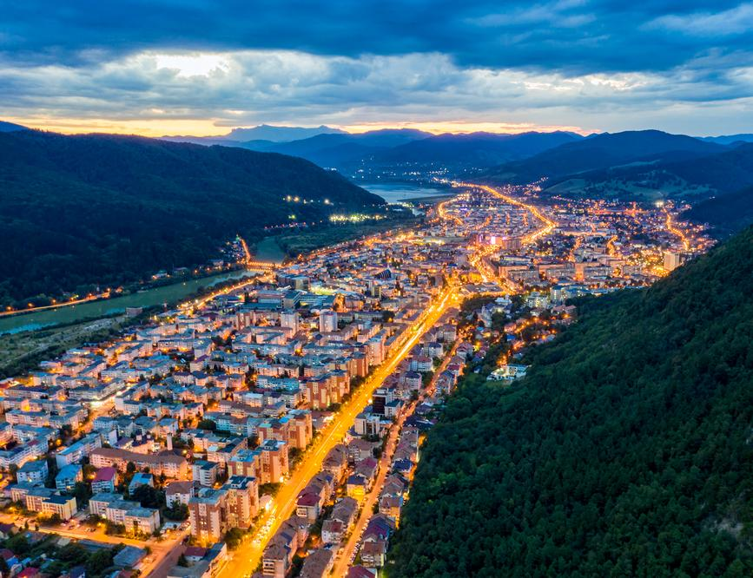
PIATRA NEAMȚ
Is the seat of the county and is located in a picturesque area, at the foot of the Eastern Carpathians.
There are a lot of attractions waiting to be visited like:

Slide 18
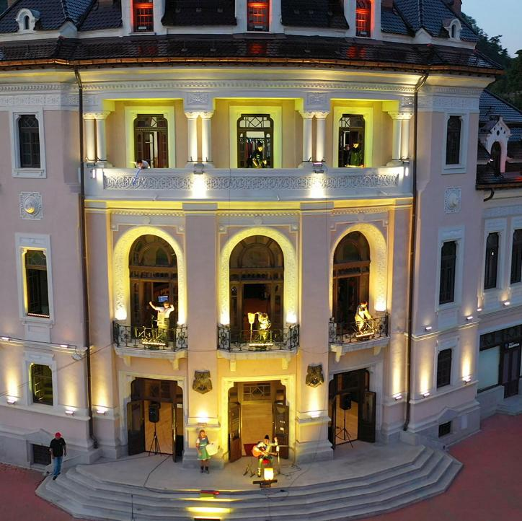
THE YOUTH THEATRE
The Youth Theatre where you can enjoy a lot of interesting plays. It is also the most important one in the county.

Slide 19
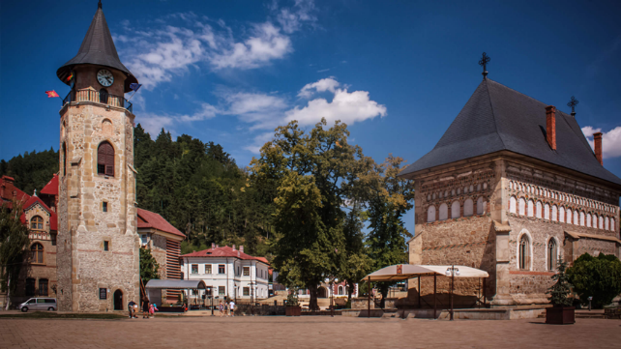
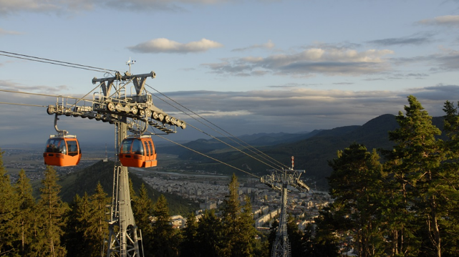
THE ROYAL COURT
In the Royal Court, which is situated in the middle of the city , The Church and The Tower of Stephen the Great can be found.
THE CABLE CAR
  The cable car which takes you on the highest mountains in the city called ”Cozla”.

Slide 20

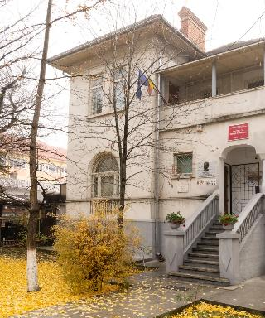
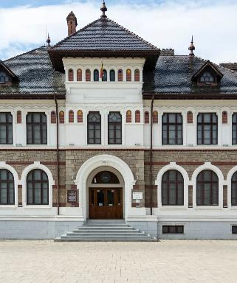
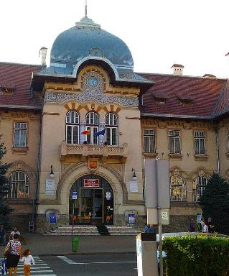
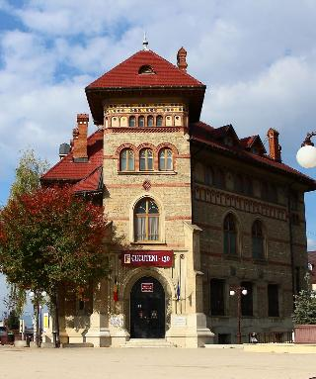
SCIENCE MUSEUM
ART
MUSEUM
HISTORY MUSEUM
CUCUTENI MUSEUM
MUSEUMS

Slide 21
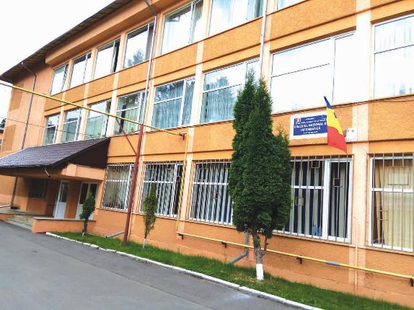
National College of Informatics
The National College of Informatics is one of the most important and significant highschool in Piatra Neamt. Not only does it teach children the great ways of computer science, for which it is well-known, but also it helps them evolve in many domains. After graduating this school, many students choose jobs from a variety of fields.
We excel at both computer science, subjects like mathematics, physics, chemistry, but also history, English and many more.

Slide 22
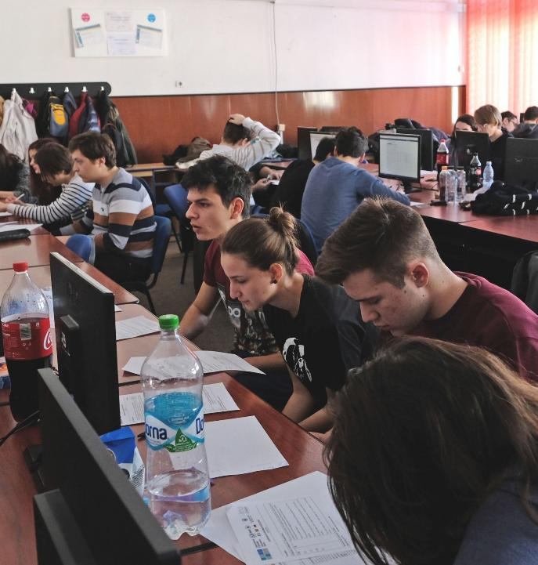
PROSOFT@NT
The projects in our school are very interesting, such as this Erasmus project we are in now, but that's not all.
The Multidisciplinary Prosoft@NT competition was initiated by the National College of Informatics at the level of the municipality of Piatra-Neamț. With the participation and support of partners from the country and abroad, it has become a prestigious competition in the field of computer science and mathematics, entered in the competitive calendar of the Ministry of Education, which attracts the best students every year.

Slide 23
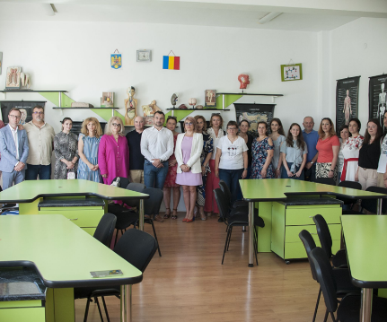
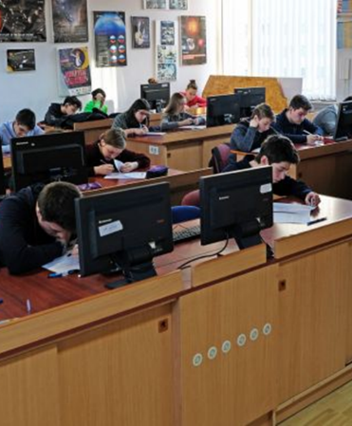
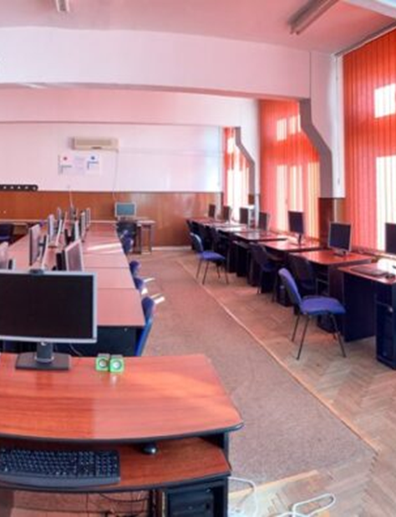
BIOLOGY
LABORATORIES
PHYSICS
We also have many modern physics, biology, chemistry and informatics laboratories where students develop their knowledge every day.
INFORMATICS

Slide 24
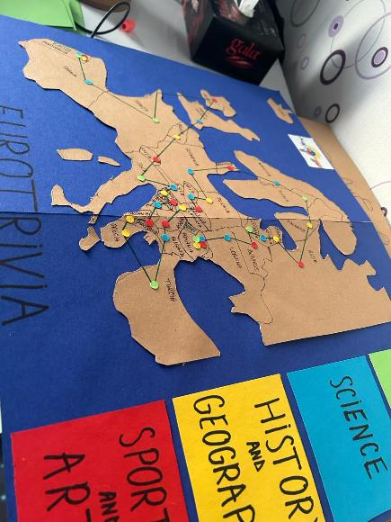
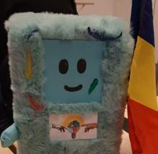
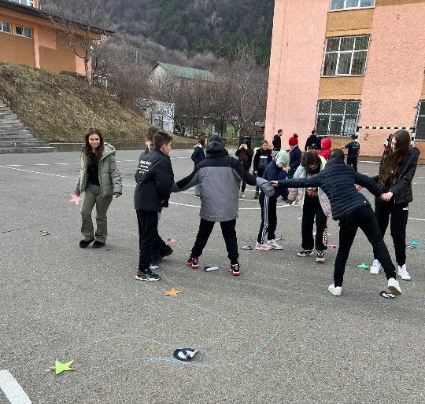
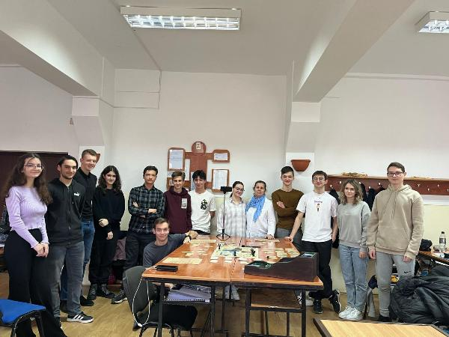
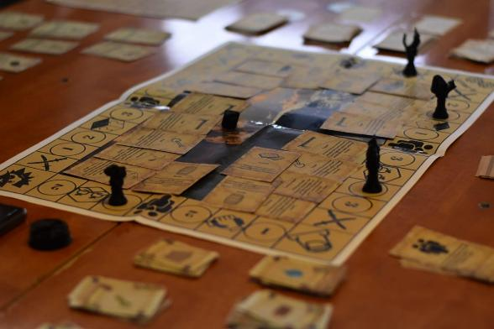
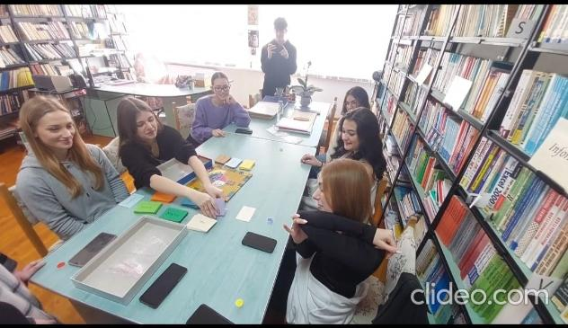
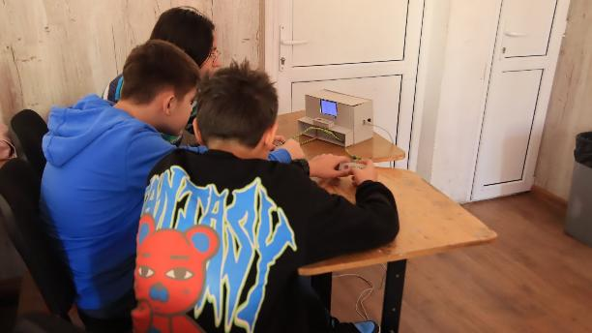
Our Erasmus+ project
Our school received an Erasmus accreditation for the years 2023-2027. There were about 150 students who applied. Then we were divided into 4 objectives. They were very different to one another and every person that got in after the selection could choose one of them, in order to improve their abilities. They cover many fields, from teaching to sustainability. After everyone completed the activities for their project, we went through some English tests. The whole selection was thrilling, and we enjoyed it very much. We believe that everyone has discovered at least one new ability of theirs.

Slide 25




O1
O2
O3
O4
Innovative teaching and learning
Digital communication and modern languages
Leadership and teamwork
Sustainability

Slide 26
O1
Innovative teaching and learning
O1 was all about innovative teaching and learning. Our job was to develop a lesson plan and present it in front of our colleagues. We had the possibility to choose any school subject and any class we wanted, including ours. Everyone tried to come up with a new way of teaching, in order to keep up the children's interests. Watching us interact with the students, our teachers could see how would we like to learn, and perhaps we even changed part of their perspective.

Slide 27
O2
Digital communication and modern languages
The activity of objective 2 was to create a journal which contains our questions about the Erasmus+ project, thoughts, memories. Basically, everything a normal journal would contain. Its purpose is to reflect on the activities of the project, to understand them better.

Slide 28
O3
Leadership and teamwork
Within Objective 3, participants were guided in creating a representative mascot for our high school in the Erasmus project. The mascot was not only meant to reflect innovation, sustainability, and creativity but also to tangibly convey these values through its symbols and design, thereby strengthening students’ commitment to leadership and communication.

Slide 29
O4
Sustainability
Objective 4 is not just about accumulating knowledge but represents a comprehensive approach aimed at efficiently transforming our community into an active agent of change towards sustainability.

Slide 30

