Slide 1
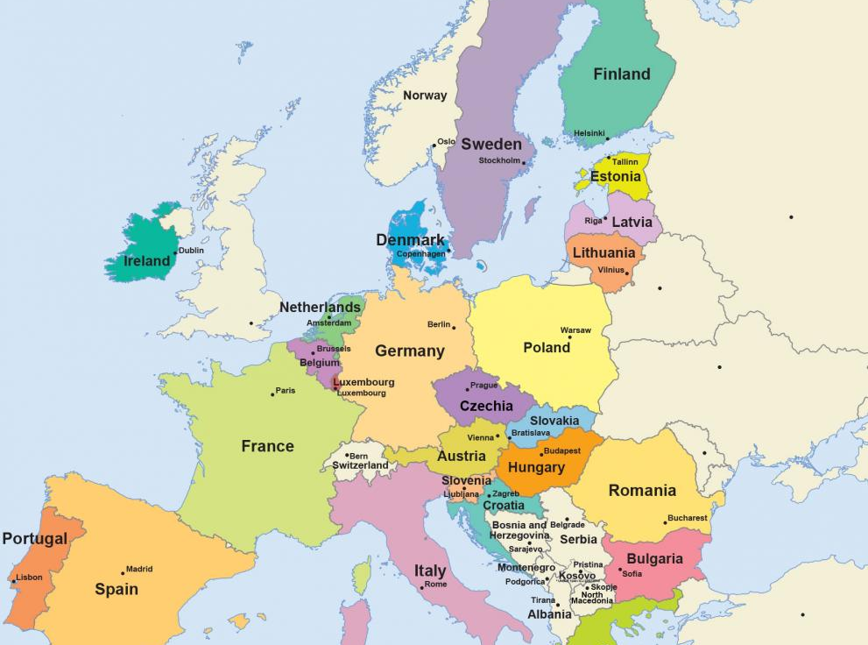
ROMANIA

Slide 2
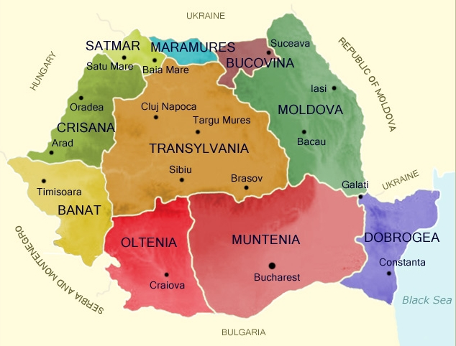
ROMANIA

Slide 3

The flag
Yellow is the symbol strength, wealth and purity. It also represents the color of baked wheat.
Red represents the blood shed in battle
Blue represents the air

Slide 4
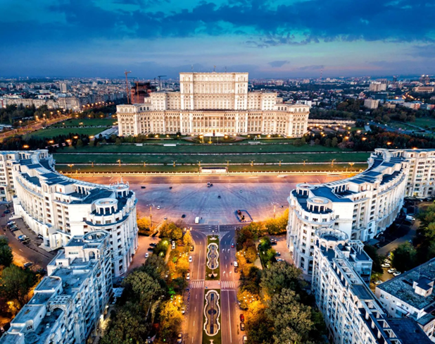
ROMANIA
GENERAL INFO:
Romania is one of the largest countries in the South-Eastern Europe.
Population: 19,78 million
Capital: Bucharest
Regions:9
Counties: 41

Slide 5
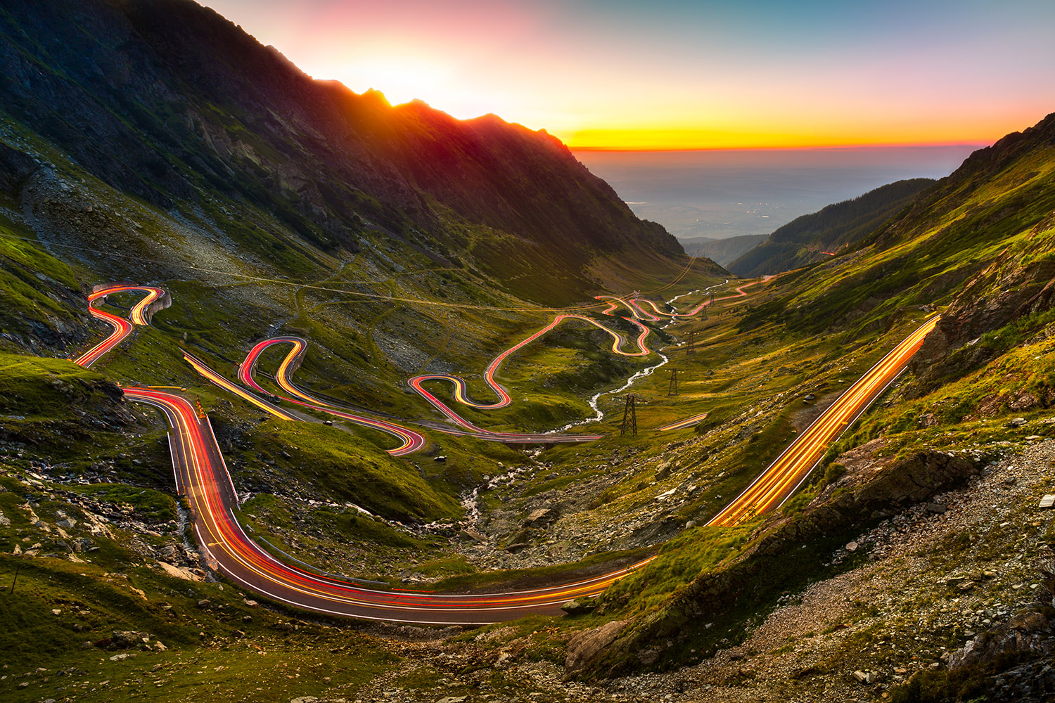
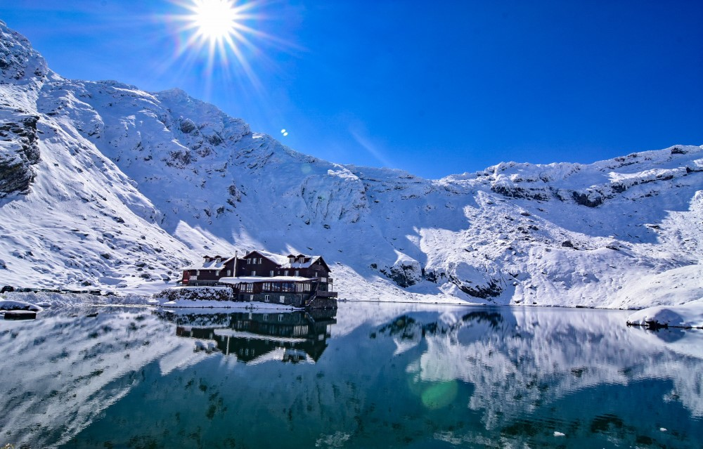
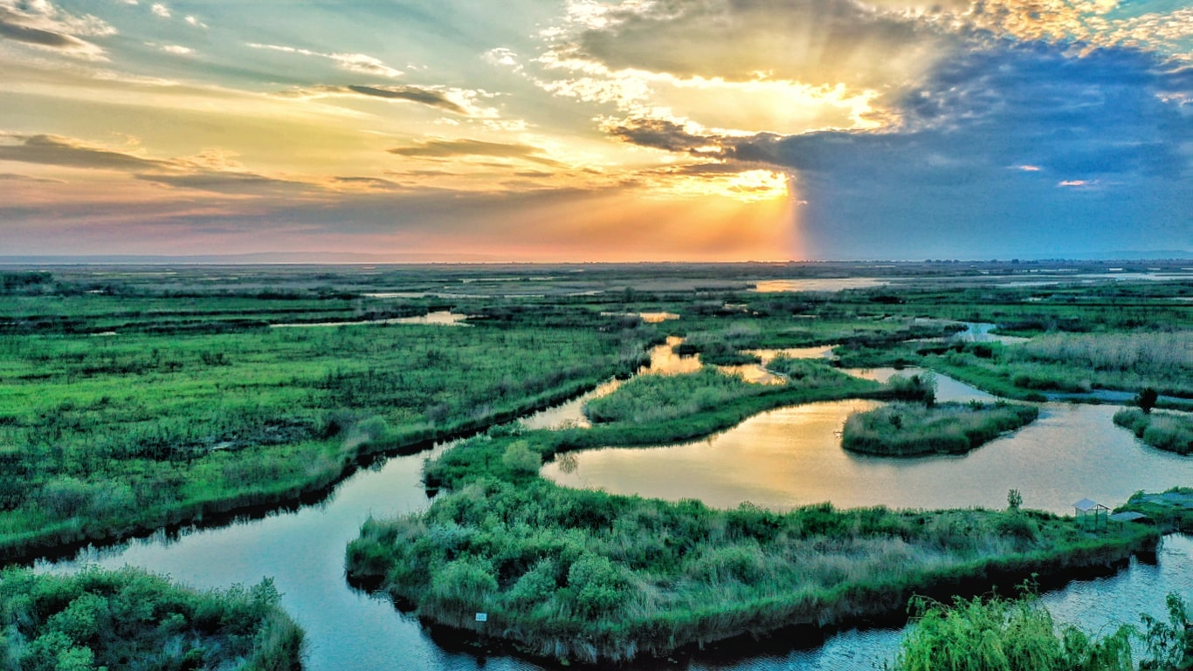
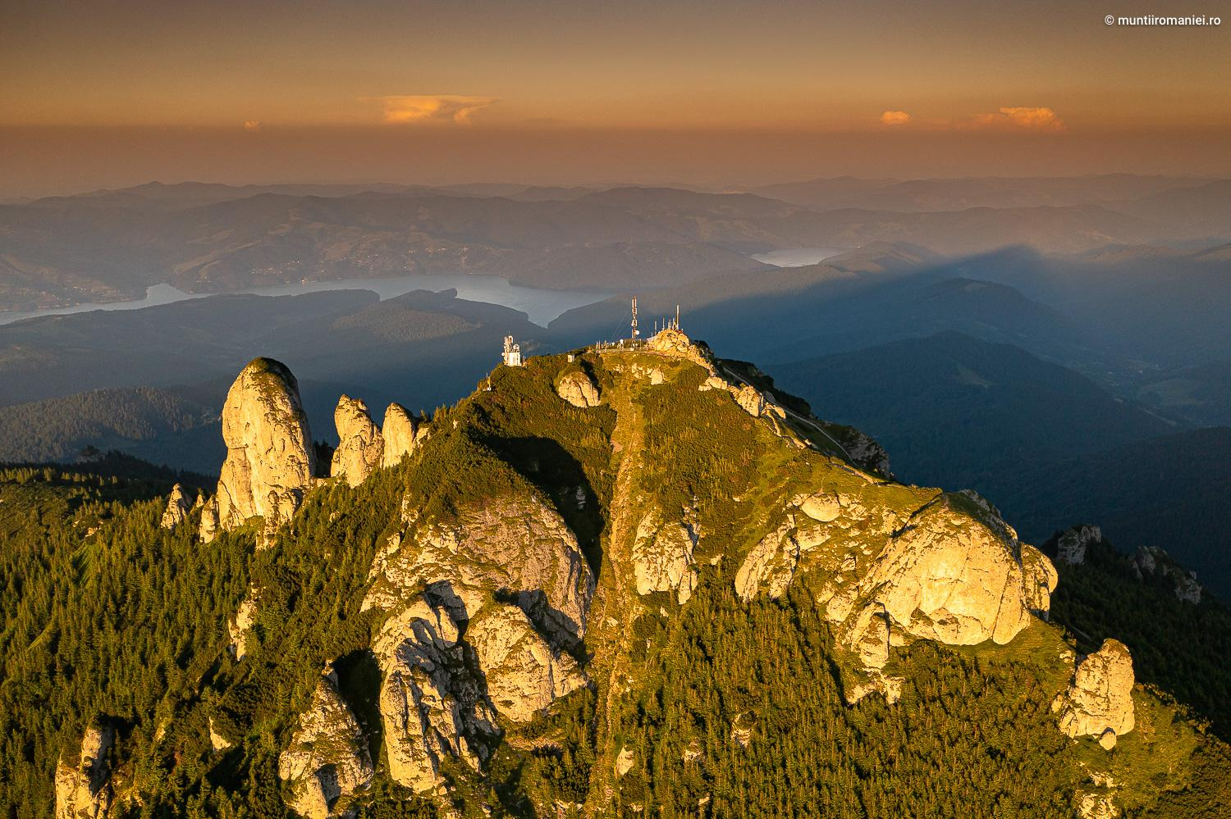
Transfăgărășan highway
Bâlea Lake
UNIQUE SCENERY FROM ROMANIA
Danube Delta
Mt. Ceahlău

Slide 6
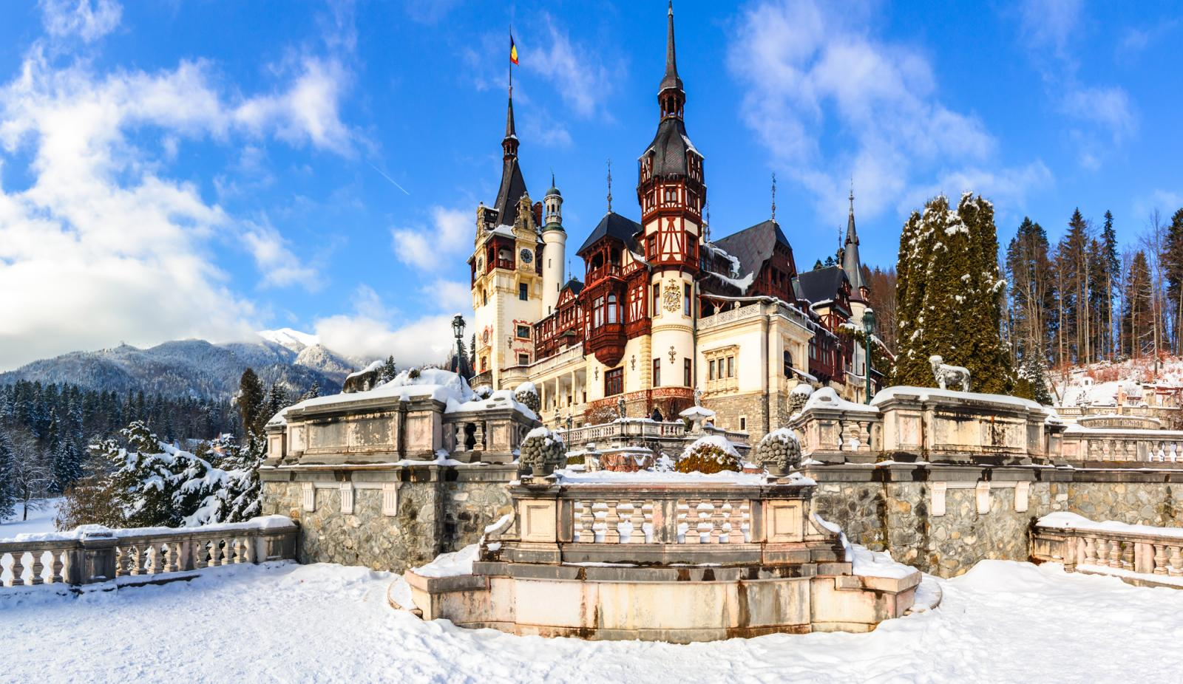
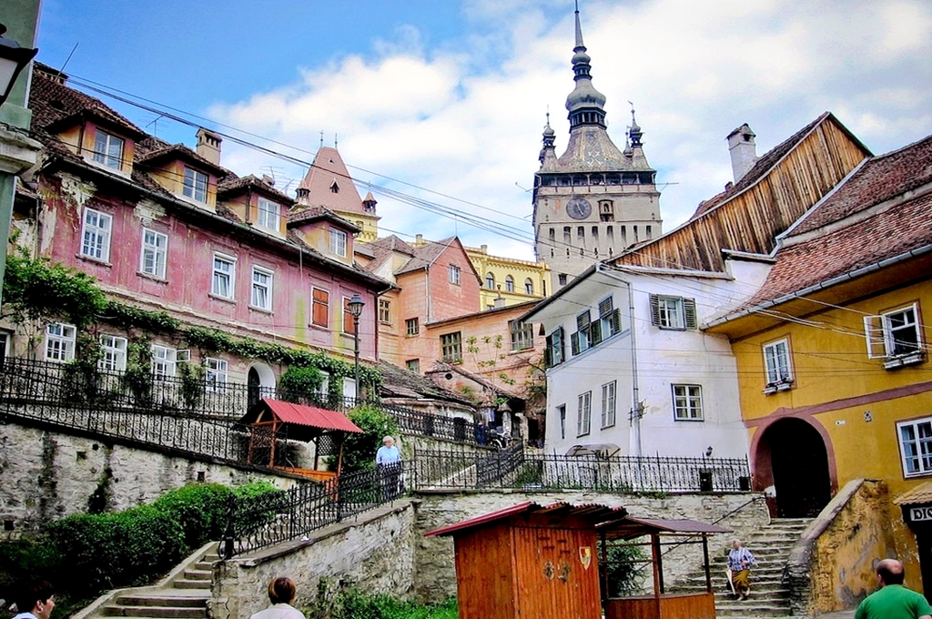
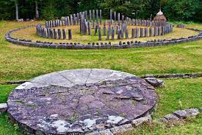
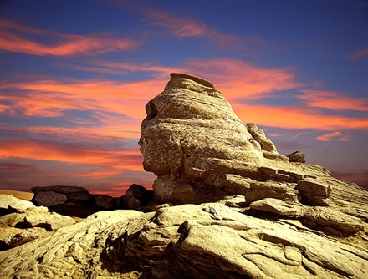
Peleș Castle
The old town of Sighișoara
UNIQUE SCENERY FROM ROMANIA
Dacian Fortress “Sarmisegetusa Regia”
The Sphinx of Bucegi Mountains

Slide 7
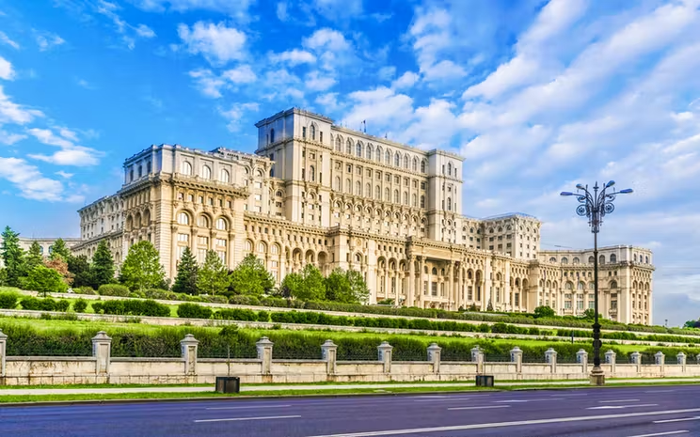
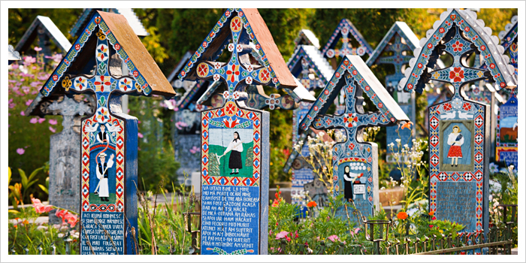
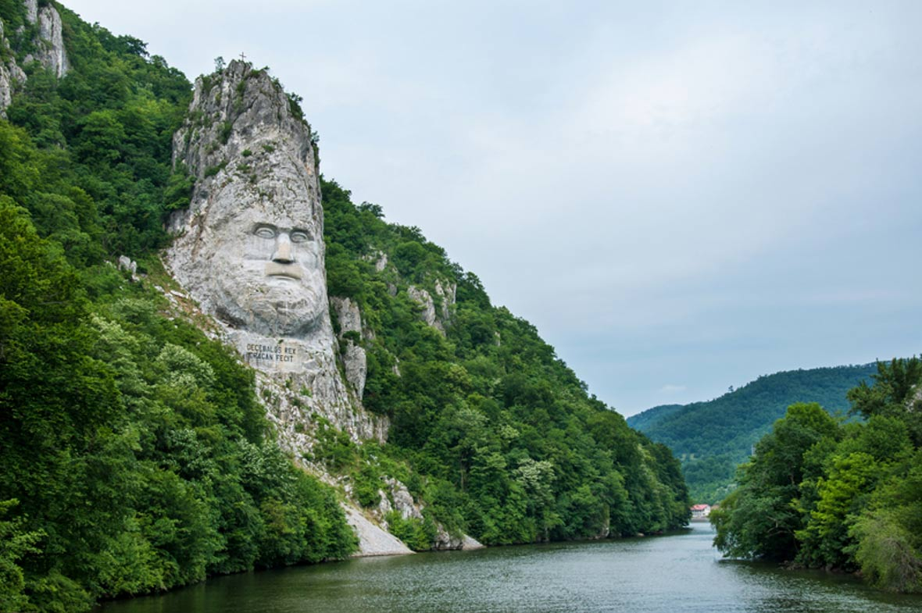
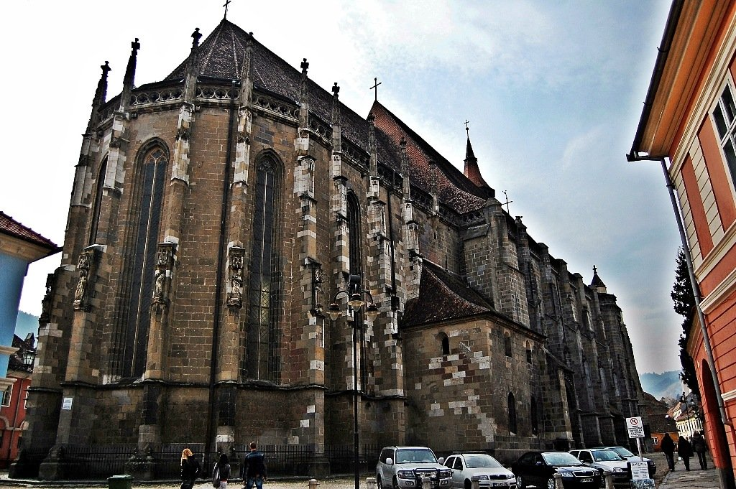
SOME FUN FACTS ABOUT ROMANIA
01
02
03
Romania Has Europe’s Largest Rock Sculpture
-Along the Danube, near the city of Orșova, there’s a rock sculpture of Decebal, which is 55 meters in height.
04
The Parliament Palace in Romania’s capital of Bucharest is the second largest building in the world, behind only the Pentagon. The building is 84m high. It is also the heaviest building in the world.
Romania has a very ‘Happy Cemetery’
The biggest Gothic church is in Romania-The Black Church of Brașov is
unparalleled in Eastern Europe, being the biggest Gothic church between Vienna and Instanbul.

Slide 8
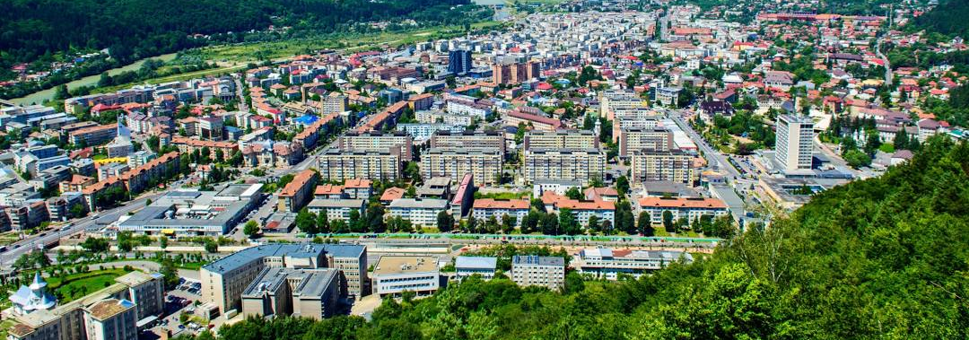
Piatra Neamț is a city located in the north-eastern part of Romania, in Neamț county. It is the seat of the county and is located in a picturesque area, at the foot of the Eastern Carpathians. The city is crossed by the river Bistrița and is surrounded by hills covered with coniferous forests.
Piatra-Neamt has a historical part called the Royal Court. That’s where you will find the Church and the Tower of Stephen the Great.
Many attractions wait for everyone, we may mention:
  Museums: Cucuteni, History, Arts, and more
  The Youth Theatre, one of the most important theaters in the country
  The cable car which takes you on the highest “mountain” from our city, Cozla
Piatra Neamț

Slide 9
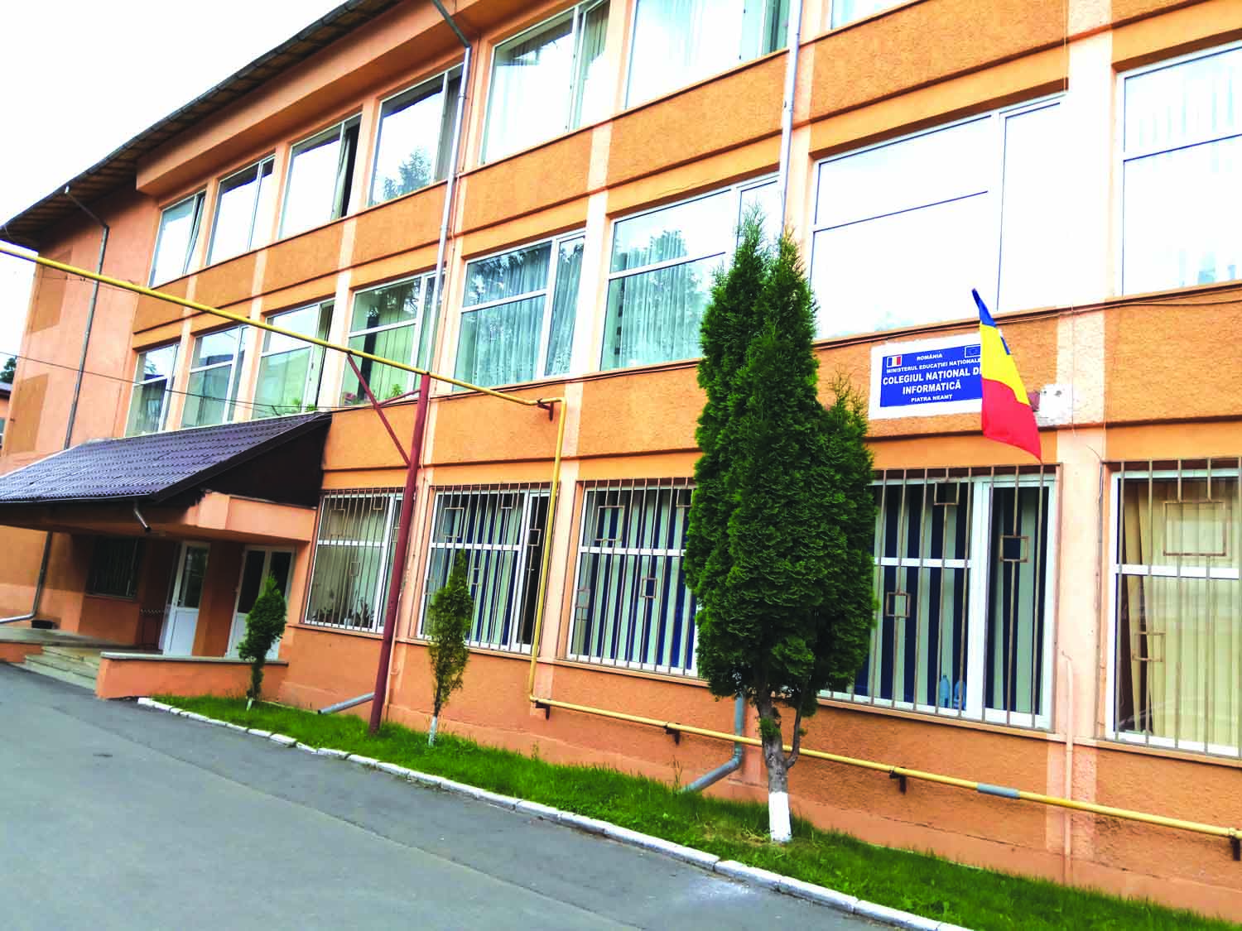
National College of Informatics
The National College of Informatics is one of the most important and significant highschool in Piatra Neamt. Not only it teaches children the great ways of computer science, for which is well-known, but also it helps them evolve in many domains. After graduating this school, many students choose jobs from a variety of fields.
We excel at both computer science, subjects like mathematics, physics, chemistry, but also history, english and many more.
http://cni.nt.edu.ro/new/

Slide 10
Our
Erasmus+ project
Our school received an Erasmus accreditation for the years 2023-2027. There were about 150 students who applied. Then we were divided into 4 objectives. They were very different to one another and every person that got in after the selection could choose one of them, in order to improve their abilities. They cover many fields, from teaching to sustainability. After everyone completed the activities for their project, we went through some English tests. The whole selection was thrilling, and we enjoyed it very much.
All of us want to learn something from you, for example, your culture, your school system or your social lives . We also want to tell you about us, and our country and we are opened to any questions.

Slide 11
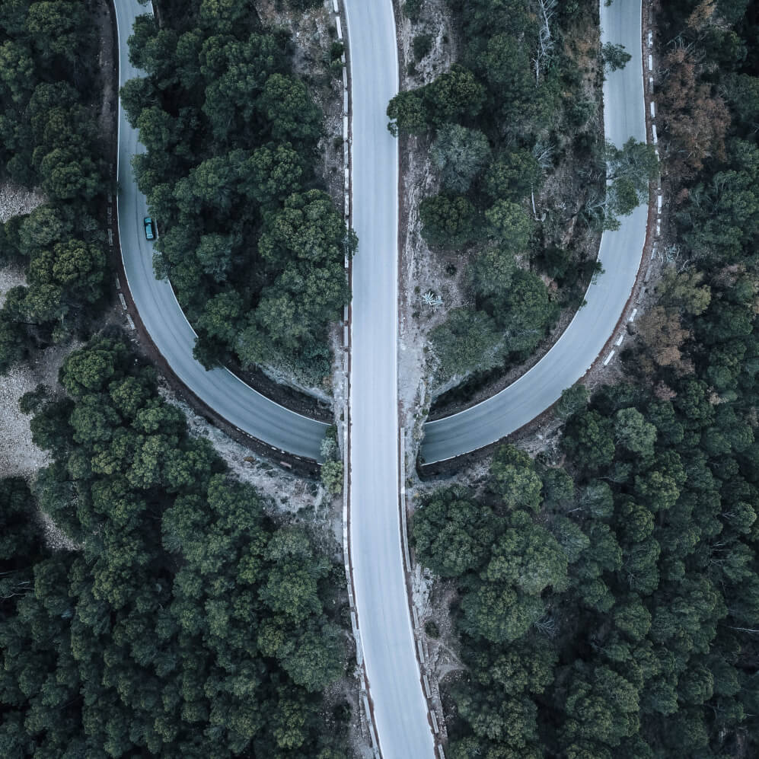
Our Erasmus+ project
Our school received an Erasmus acreditation for the years 2023-2027. There were about 150 students who applied. Then we were divided into 4 objectives. They were very different to one another and every person that got in after the selection could choose one of them, in order to improve their abilities. They cover many fields, from teaching to sustenability. After everyone completed the activities for their project, we went through some English tests. The whole selection was thrilling, and we enjoyed it very much. We believe that everyone has discovered at least one new ability of theirs.
All of us want to learn something from you, because you are very different from us, from your schooling programme to your social lives. We also want to teach you about ourselves and our country and we are opened to any questions. We really hope that this will be an experience that we ll never forget and we want to connect with you and establish a bond between our lives and cultures.
The experience in Sweden will be exquisite for sure and we hope that you will enjoy it with us.

Slide 12
Objective 1
Objective 2
Objective 3
Objective 4
O1 was all about innovative teaching and learning. Our job was to develop a lesson plan and present it in front of our colleagues. We had the possibility to choose any school subject and any class we wanted, including ours. Everyone tried to come up with a new way of teaching, in order to keep up the children's interests. Watching us interact with the students, our teachers could see how would we like to learn, and perhaps we even changed part of their perspective.
The activity of objective 2 was to create a journal which contains our questions about the Erasmus+ project, thoughts, memories. Basically, everything a normal journal would contain. Its purpose is to reflect on the activities of the project, to understand them better.
Within Objective 3, participants were guided in creating a representative mascot for our high school in the Erasmus project. The mascot was not only meant to reflect innovation, sustainability, and creativity but also to tangibly convey these values through its symbols and design, thereby strengthening students’ commitment to leadership and communication.
Objective 4 is not just about accumulating knowledge but represents a comprehensive approach aimed at efficiently transforming our community into an active agent of change towards sustainability.

